Slide 1

HUMAN MACHINE INTERACTION
DEPARTMENT OF COMPUTER ENGINEERING
SEMESTER VIII

Slide 2
Examination Scheme
Total- 150M
End Sem Exam
80M
Internal Assessment
(AVG-20M)
IA-1
(20M)
IA-2
(20M)
Oral 25M
TW
25M

Slide 3
Modules
Understanding goal directed design
Introduction
GUI
Interaction styles
Design guidelines
Communication

Slide 4

Text Books/Reference Book
Textbooks:
Galitz’s, “Human Machine Interaction”, Dr. Dhananjay R. Kalbande, Wiley Publication
Wilbert O. Galitz, “The Essential Guide to User
Interface Design”, Wiley publication.
Reference Books:
Donald A. Norman, “The design of everyday things”, Basic books.

Slide 5
Chapter 1- Introduction
It is the way in which the machine is presented to the human

Slide 6
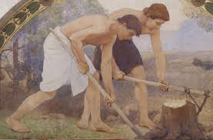


Generations
First Generation: Machine that reduce Physical labor

Slide 7

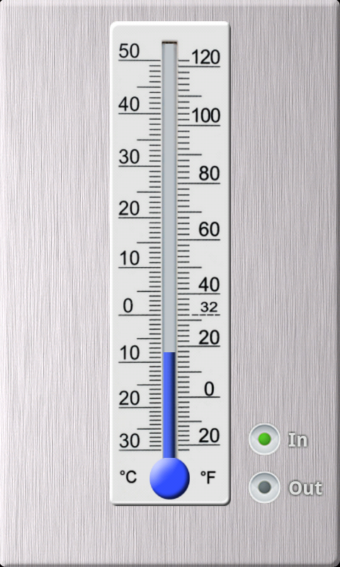

Second Generation: Machines that displayed output

Slide 8
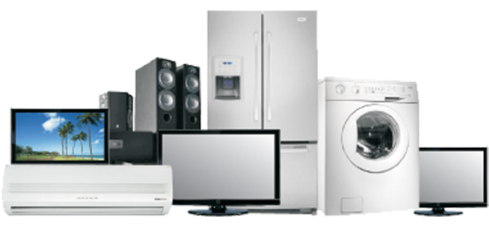
Third Generation: Machines that provided output with feedback

Slide 9
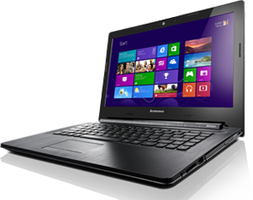
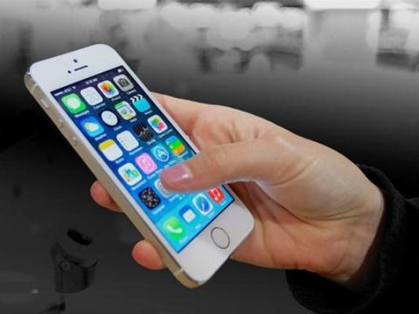
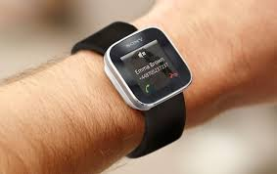
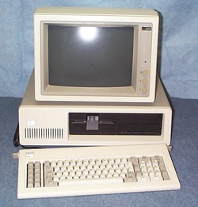
Fourth Generation: Machines with computing power

Slide 10
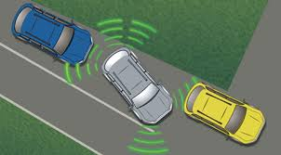

Fifth Generation: Intelligent Machines

Slide 11
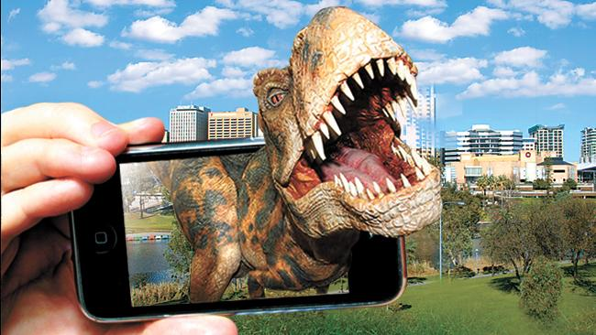
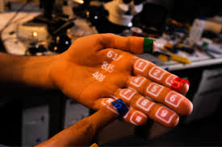
Future: Augmented Reality

Slide 12
Hardware, Software and Operating Environments
1. Hardware
Most important utility
Used to drive software
Today we choose hardware as per our requirements
Plenty hardware options are available and no need to compromise

Slide 13
Hardware, Software and Operating Environments
2. Software
Tool to create an effective user interface
Based on requirements and hardware we need to choose software
It can use LLL, Assembly language or HLL
Many front end development tools using audio/visual experience to user

Slide 14
Hardware, Software and Operating Environments
3. Operating environment
Fulfill user level acceptance test and can provide modification
Key points of user interface
Friends, family members, colleagues are not representatives of target users
User requirements should be understood by a team and not by an individual
Goal should be to minimize user difficulties
The hardware (device) and software balance should be maintained

Slide 15
The Psychopathology of everyday things
Human-Centered Design
Considering different users and their aspects
Experience, knowledge, intelligence of users
Conceptual Model or mental model
Feedback
Constraints
Affordances (Convey the rules by leaving visual clues)
Power of observation

Slide 16
Norman’s Fundamental Principles of Interaction
Affordance
Signifiers
Perceived Affordance
Mapping
Feedback
Conceptual Models

Slide 17


Slide 18
Seven Stages of Action
1. Forming the goal
Execution
2. Forming the intention (plan)
3. Specifying an action (specify)
4. Executing the action (perform)
Evaluation
5. Perceiving the state of the world (perceive)
6. Interpreting the state of the world (reflect)
7. Evaluating the outcome (compare)

Slide 19
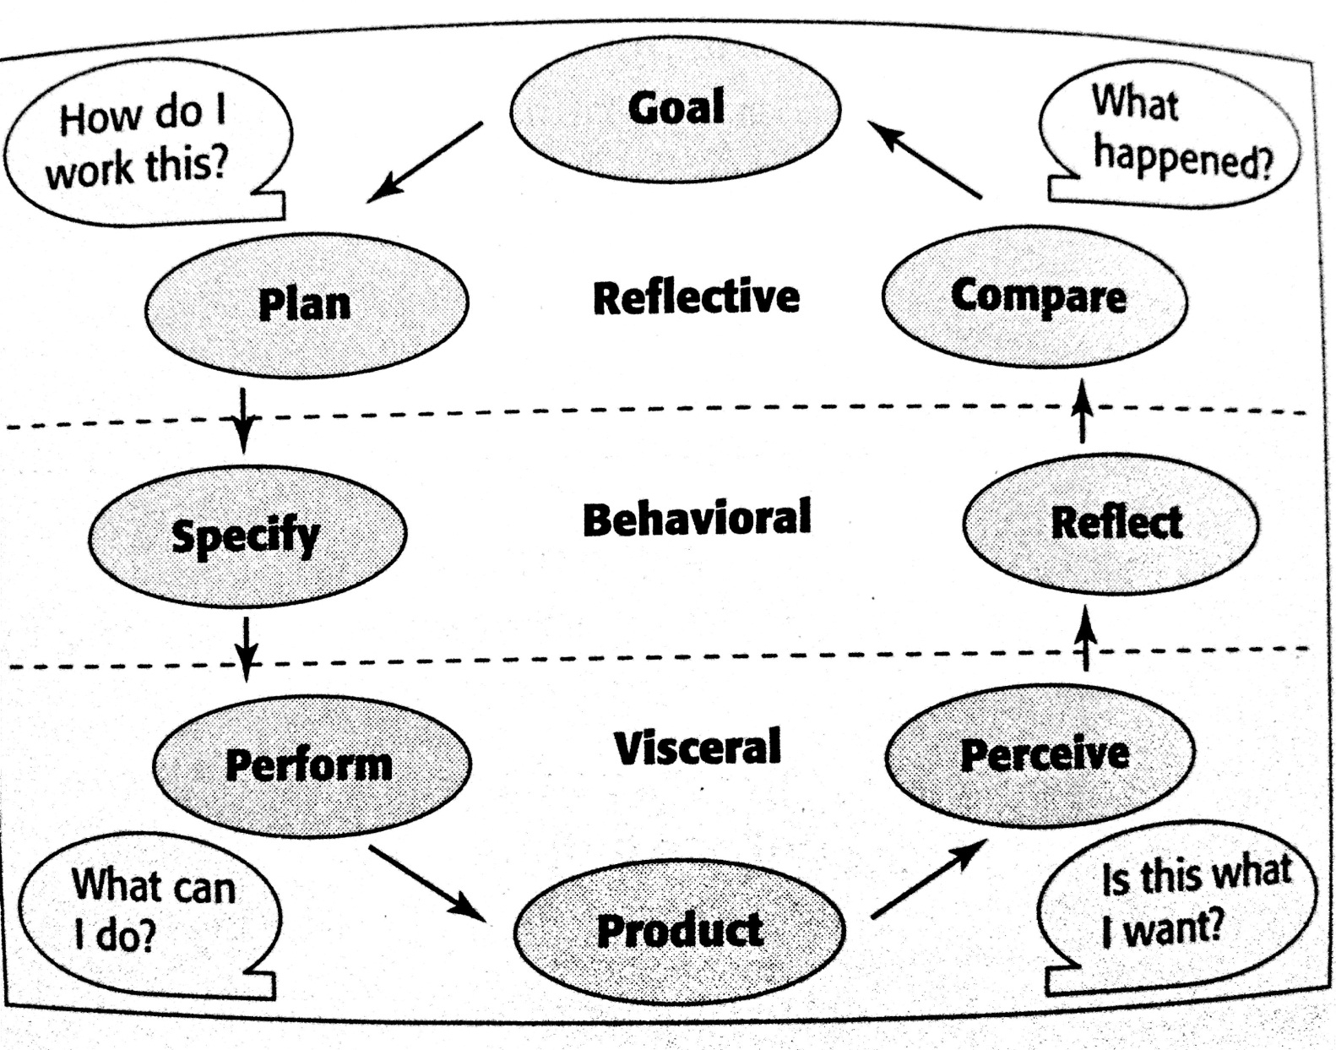
Three levels of Processing
Visceral level
Behavioral level
Reflective level

Slide 20
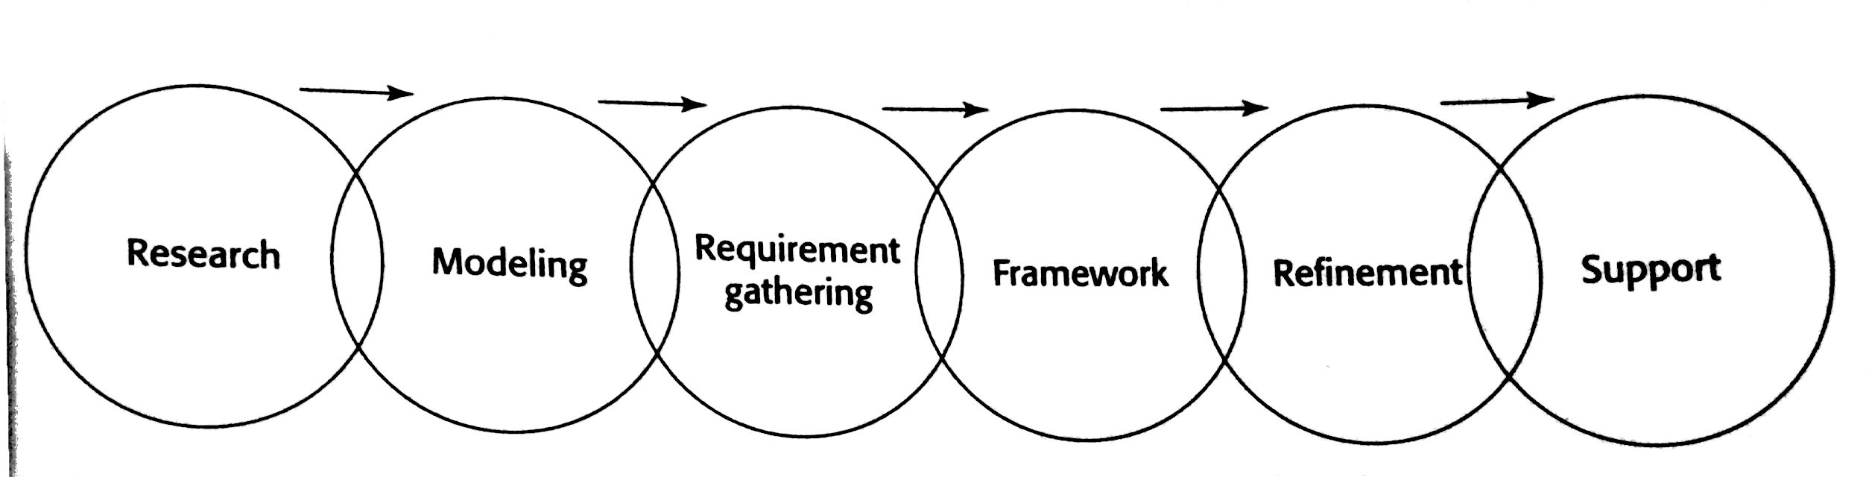
Chapter 2- Goal Directed Design
Goal Directed Design Process

Slide 21
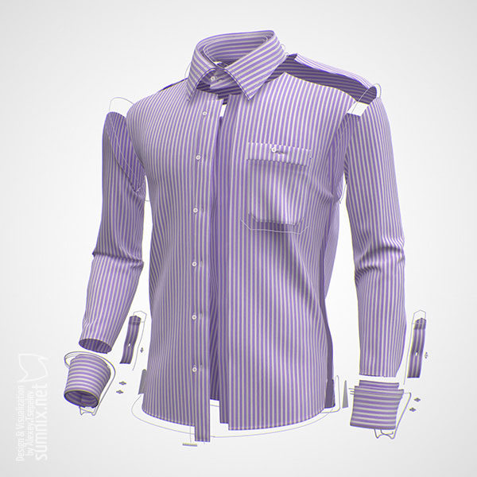
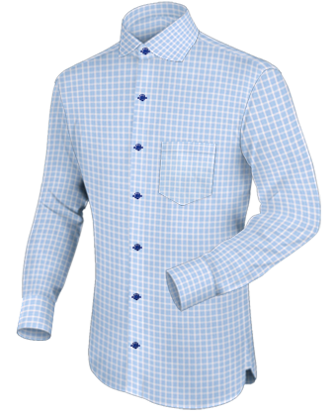
Implementation Model and Mental Model

Slide 22
Beginners, Experts and Intermediates
Most users are neither beginners nor experts
Skill spectrum dynamics
Accommodating beginners
Intermediates
Accommodating experts

Slide 23
Quantitative versus Qualitative research
Quantitative Research | Qualitative Research
It is statistics of human activities | The detailed information that provides the knowledge about behaviour, attitude of the user
It helps to forecast the use of the interface | It helps to identify any existing same or similar products are available
It will try to resolve the quantity of copies of product to be delivered to users | It helps in environmental contexts of the product being designed
It will help in earlier dialog between the developers and end users | It helps the design team as the design decisions are traced from the quantitative research

Slide 24
Value of Qualitative research
Stakeholder Interview
Primary vision of product
Budget and the schedule
Technical and non technical issues
Business drivers
Stakeholder perceptions
SME Interviews
SMEs are often expert users
SMEs are experts but they are not designers
SME help in regulating the standards
SMEs will be a valuable resource throughout the design process

Slide 25
Customer Interviews
Goal
Current difficulties
Who makes a decision
What is decision making channel
What is business logic
User Observation and Ethnographic interviews
Context
Partnership
Interpretation
Focus

Slide 26
Persona
Helps to determine, communicate, build consequences, measure and
contribute the design quality of product
Goals
Steps in constructing personas:
1. Identify behavioral variables
2. Map interview subjects to behavioral variables
3. Identify behavioral patterns
4. Synthesize characteristics and relevant goals
5. Check for redundancy and completeness
6. Expand description of attributes and behaviors
7. Designate persona

Slide 27
Chapter 3- GUI
The Concept of Direct Manipulation
Characteristics:
The system should portrayed as an extension of the real world
Continuous visibility of objects and actions
Actions should rapid and incremental with visible display and results
Incremental actions should easily reversible

Slide 28
Graphical Systems:
Advantages:
Symbols recognized faster than text
Faster learning
Faster use and problem solving
Easier remembering
More natural
Fewer errors
Less difficult for new user
More attractive
Replaces natural languages
Low typing requirements

Slide 29
Disadvantages
Greater design complexity
Learning still necessary
Not always familiar
Human comprehension limitations
Window manipulation requirements
Production limitations
Inefficient for expert users
Increased chances of clutter and confusion
May consume more memory space
Hardware limitations

Slide 30
Characteristics of Graphical user interface
Sophisticated visual presentation
Pick and click interaction
Restricted set of interface options
Visualization
Object orientation
Collection
Constraints
Composites
Container
6. Use of recognition memory
7. Concurrent performance of functions

Slide 31
Characteristics of Web user interface
Device
Data/ Information
User tasks
Interaction
Response time
Visual style
System capability
Consistency
Security
Reliability

Slide 32
Principles of User interface design
Visual pleasing
Clarity
Compatibility
Comprehensibility
Configurability
Directness
Efficiency
Familiarity
Flexibility
Forgiveness
11. Predictability
12. Recovery
13. Responsiveness
14. Simplicity
15. Transparency

Slide 33
Chapter 6- Communication
Words, Sentences, Messages and text
Words
Jargon
Abbreviations or acronyms
Short familiar words
Complete words
Positive terms
Consistent words

Slide 34
Sentences
Brief and simple
Directly and immediately usable
Affirmative statement
Active voice
Temporal sequence
Main topic at beginning
Non authoritarian
Non threatening
Punishment and humor

Slide 35
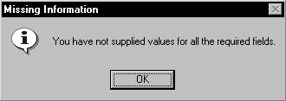
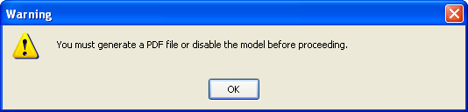
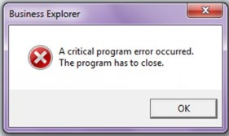
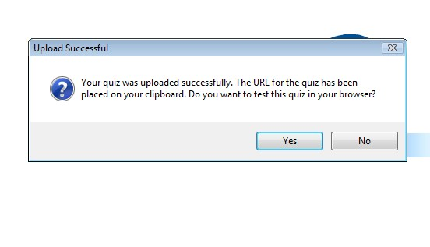
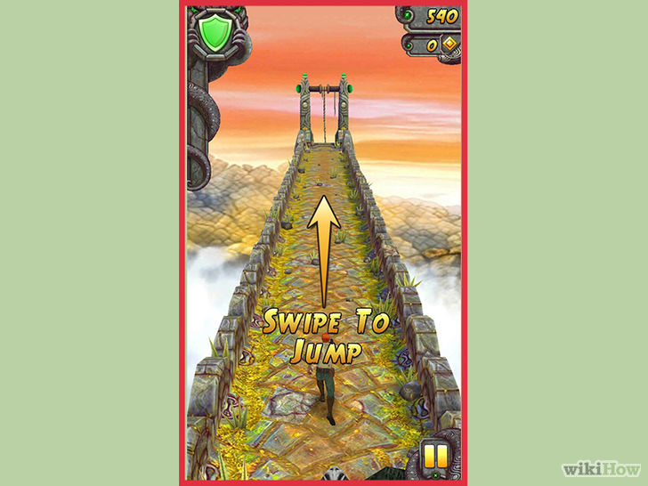
Messages
A. System messages
Status messages
Informational messages
Warning messages
Critical messages
Question messages
B. Instructional messages

Slide 36



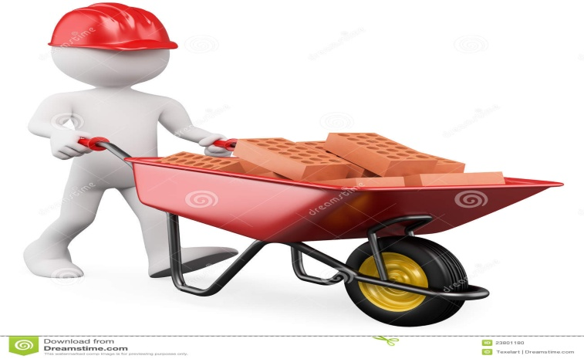

Icons and Multimedia
Icons
A. Kinds of icons
1. Resemblance
2. Symbolic
3. Exemplar
4. Arbitrary
5. Analogy

Slide 37
Icons
B. Technical qualities
1. Syntactics
2. Semantics
3. Pragmatics

Slide 38
Icons
C. Characteristics
1. Clarity
2. Familiarity
3. Simplicity
4. Consistency
5. Directness
6. Efficiency
7. Discriminability
8. Expectancies

Slide 39
Icons
D. Choosing icons
1. A successful icons
2. Size
3. Color
4. Icon selection
5. Hot zone
E. Choosing images
1. Existing icons
2. Nouns
3. Traditional images
4. Cultural or social norms

Slide 40
Icons
F. The design process
1. Define purpose
2. Collect, evaluate and sketch ideas
3. Draw in black and white
4. Test for expectations, recognition and learning
5. Test for legibility
6. Register new icon in the system registry

Slide 41
Multimedia
Graphics
Types:
1. Navigational
2. Representational
3. Organizational
4. Explanative
5. Decorative
Characteristics:
1. Supplement textual content
2. Convey information not possible using text
3. Limit long loading graphics
4. Enhance navigation

Slide 42
Multimedia
B. Images
1. Standard images
2. Consistency
3. Legibility
4. Descriptive text or labels
5. Navigational and decorative images
6. Minimize number of images
7. Minimize size of an image
8. Thumbnail size
9. Minimize animation
10. Minimize the number of colors
11. Appropriate format

Slide 43
Multimedia
C. Photographs/Pictures
1. Use
2. Guidelines
D. Videos and audios
1. Use
2. Disadvantages
3. Guidelines

Slide 44
Multimedia
E. Diagrams and drawings
1. Use
2. Guidelines
F. Animation
1. Use
2. Disadvantages
3. Guidelines

Slide 45
Colors
A. Possible problems with colors
1. High attention getting capacity
2. Interference with use of other screens
3. Varying sensitivity of the eyes to different colors
4. Color viewing deficiencies
5. Cross disciplinary and cross cultural differences

Slide 46
Colors
B. Choosing colors
1. Choosing colors for categories of information
2. Discrimination and harmony
3. Emphasis
4. Common meanings
5. Location
6. Ordering
7. Foreground and background
8. Color palette, defaults and customization
9. Gray scale
10. Monochromatic screens
11. Consistency
12. Cultural, disciplinary considerations

Slide 47
Chapter 5- Interaction Styles
Characteristics of device based controls
To point an object on the screen
To select the object
To drag an object across the screen
To draw something on the screen
To track or follow a moving object
To orient or position an object
To enter or manipulate data or information

Slide 48
Device based controls
Trackball
Description
Advantages
Direct relationship between hand and pointer
Does not obscure vision on screen
Does not require additional desk space

Slide 49
Disadvantages
Movement is in different plane from screen
Requires large degree of eye-hand coordination
Requires hand to be removed from keyboard keys
Requires additional desk space if not mounted on keyboard
May be difficult to control

Slide 50
Joystick
Description
Advantages
Direct relationship between hand and pointer movement in terms of direction
Does not obscure vision on screen
Does not require additional desk space if mounted on keyboard
Disadvantages
Movement is different from screen
Requires large degree of eye-hand coordination
Requires hand to be removed from keyboard keys
Requires different hand movements to use
Requires additional desk space if not mounted on keyboard
May be difficult to control
May be slow and inaccurate

Slide 51
Graphic Tablet
Description
Advantages
Direct relationship between touch movements and pointer movement in terms of direction, distance and speed
Does not obscure vision on screen
More comfortable horizontal operating plane
Disadvantages
Requires hand to be removed from keyboard keys
Requires different hand movements to use

Slide 52
Touch Screen
Description
Advantages
Direct relationship between touch movements and pointer movement in terms of direction, distance and speed
Movement is direct, in the same plane as screen
Requires no additional desk space
Stands up well in high use environments
Disadvantages
Fingers may obscure part of screen
Requires moving the hand far from the keyboard to use
Fingers may be too large for accuracy with small objects
May soil or damage the screen

Slide 53
Design Guidelines
Screen object should be at least 3/4”X3/4” in size
Object separation should be at least 1/8”
Provide visual or audio feedback
Sometimes requires confirmation
Provide an instructional invitation to begun using.

Slide 54
Light Pen
Description
Advantages
Direct relationship between hand and pointer movement in terms of direction, distance and speed
Movement is direct, in the same plane as screen
Requires no additional desk space
Stands up well in high use environments
More accurate than finger touching
Disadvantages
Hand may obscure part of screen
Requires moving the hand far from the keyboard to use
Requires picking it up to use

Slide 55
Voice
Description
Advantages
Simple and direct
Useful for people who cannot use a keyboard
Useful when user’s hands are occupied
Disadvantages
High error rates
Slower throughput than with typing
Difficult to use in noisy environment
Impractical to use in quite environment

Slide 56
Mouse
Description
Advantages
Direct relationship between touch movements and pointer movement in terms of direction, distance and speed
Permits a comfortable hand resting position
Selection mechanisms are included on mouse
Does not obscure vision of the screen
Disadvantages
Movement is different from screen
Requires hand to be removed from keyboard
Requires additional desk space
May requires long movement distances
Requires a degree of eye-hand coordination

Slide 57
Keyboard
Description
Advantages
Familiar
Accurate
Useful for entering text, inserting text, keyed shortcuts
Disadvantages
Slow for non-touch typist
No direct relationship between finger or hand movement on the keys and cursor movement on screen in terms of speed and distance

Slide 58
Selection of device based controls
Keyboard versus mouse
Control research
a. For stationary target-Touch screen and light pen
b. For accuracy in stationary target-Mouse, trackball, graphic tablet
c. For slowest operations-Joystick
d. For small and slowly moving targets-Mouse, trackball , graphic tablet

Slide 59
Guidelines for selecting the proper device based control
Task characteristics
a. Keyboard
b. Mouse | Pointing | Selecting | Drawing | Dragging
c. Joystick |  | Selecting |  | Tracking
c. Trackball | Pointing | Selecting |  | Tracking
d. Touch screen | Pointing | Selecting
e. Graphic tablet | Pointing | Selecting | Drawing | Dragging

Slide 60
2. User characteristics and preferences
3. Environmental characteristics
4. Hardware characteristics
5. The device in relation to the application
6. Flexibility
7. Minimizing eye and hand movements

Slide 61
Pointer guidelines
A. General
Visible
Contrast with its background
Maintain its size
Hotspot should be easily locate
Location should not warp
B. Shape
Indicate its purpose and meaning
Already defined shapes
Not used for any other purpose than defined
Not many shapes
C. Animation should not get distracted

Slide 62
Characteristics of screen based controls
Permit the entry or selection of a particular value
Permit the changing or editing of a particular value
Display only a particular piece of text, value or graphic
Cause a command to be performed
Possess a contextual pop-up window

Slide 63
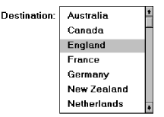
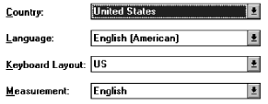


Screen based controls
Buttons and command buttons
Text entry/ read only controls
a. Text boxes
b. Multiple line text boxes
Selection controls
a. Radio buttons
b. Check boxes
c. Palettes
d. List boxes
e. Drop down list boxes
Combination entry
a. Spin boxes
b. Combo boxes

Slide 64

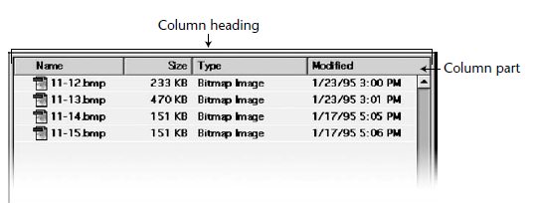

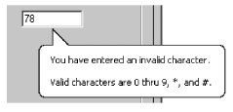
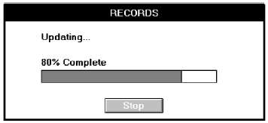

Other operable controls
a. Slider
b. Tabs
c. Date picker
d. Tree view
e. Scroll bars
Presentation controls
a. Group boxes
b. Column headings
c. Tooltips
d. Balloon tips
e. Progress indicators
f. Sample box

Slide 65
Selection of screen based controls
Selecting the proper control
a. Choose familiar controls
b. Consider the task
c. Reduce the number of clicks
d. Display as many control choices as possible
2. Entry versus selection
a. Choosing a type of control
b. Aided versus unaided entry

Slide 66
Control selection criterion
Data considerations
a. Mutually exclusive or non exclusive
b. Discrete or continuous
c. Limited or unlimited in scope
d. Data ordered in predictable or unpredictable fashion
e. Represented pictorially or not
Task considerations
a. How often is an item entered or selected?
b. How often is an item changed?
c. How precisely must the item be entered or selected?

Slide 67
User considerations
a. How much training in control operation will be provided?
b. How meaningful or known is the property or data to the user?
c. How easily remembered or learned by the user is the property or data?
d. How frequently used will the system be?
e. Is the user an experienced typist?
Display considerations
How much screen space is available to display the various controls?

Slide 68
Chapter 4- design guidelines

